Slide 1
NOBLE NARWHALS
WAYS TO BE HELPFUL BOOK

Slide 2
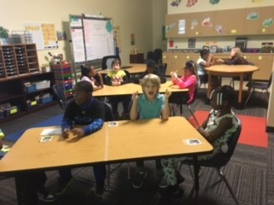
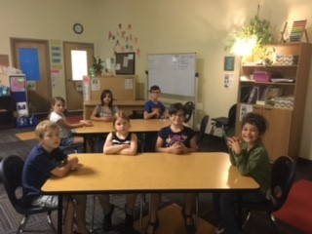
When my safe keeper is talking..
I MAY..
Listen
Put my eyes on her
I MAY NOT..
Continue to talk

Slide 3
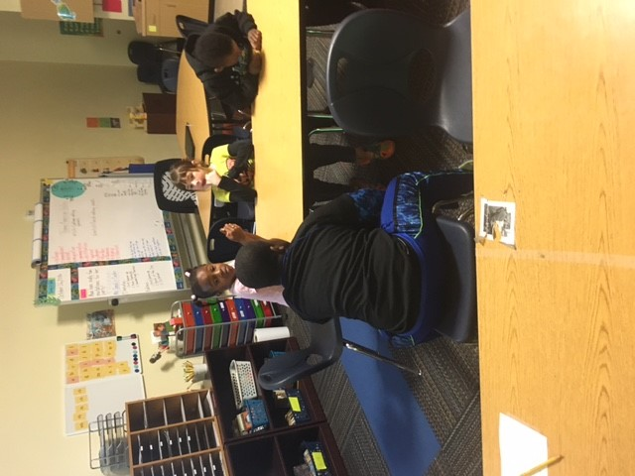
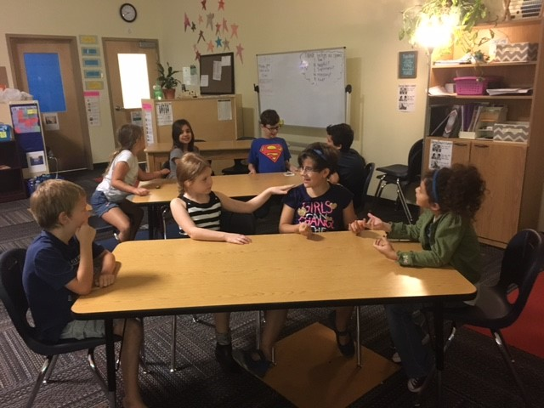
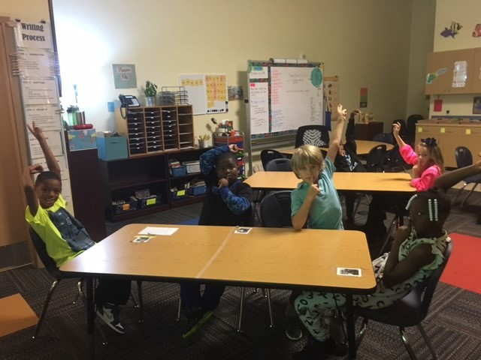
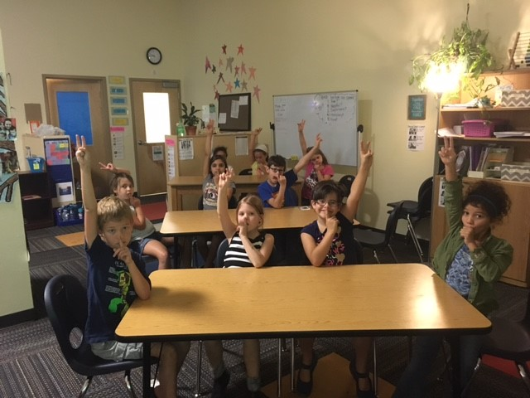
When my teacher says “Noble Narwhals”
I MAY..
Put my finger on my mouth
Raise one hand above my head
I MAY NOT..
Continue to talk

Slide 4
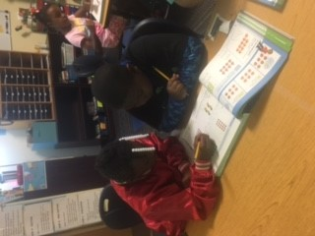
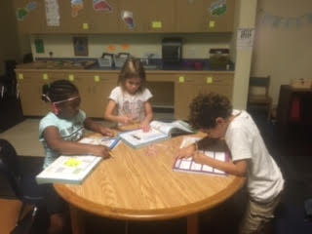
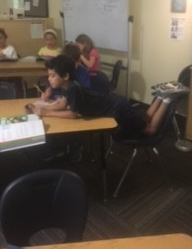
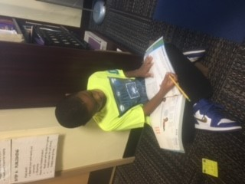
When I am working on classwork..
I MAY NOT..
Talk
Be unsafe with my body
I MAY..
Work safely at my seat or on the floor

Slide 5
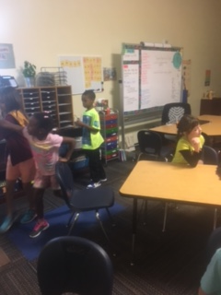
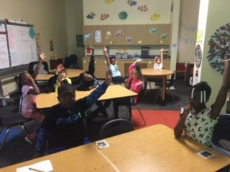
When a class brother or sister is having a hard time…
I MAY…
Wish them well
Raise my hand to ask for a safe keeper’s help
I MAY NOT…
Intervene

